Slide 1
Big Data Project
Covid-19 Tweets Sentimental Analysis
Antarjita Mandal Nayana CS Reddy Sana Rahman
Section:D Section:E Section:D
SRN:PES2201800409 SRN:PES2201800510 SRN:PES2201800665

Slide 2
INTRODUCTION
In the view of the pandemic many have tweeted regarding the Covid-19 . It becomes essential to analyse the impact of the onset of the covid-19 pandemic. One best way is to assign a polarity to the tweet and determine which tweet is positive, negative and neutral.
ABOUT OUR DATASET
Our data set is Coronavirus (covid19) Tweets - early April from kaggle. It consists of 18 files each containing 22 columns. It contains various columns like friends_count, followers_count, country_code etc and we can check the validity of the account through columns like verified etc.
TOOLS USED:-
We have used Hdfs as the underlying storage. Hive is used for basic query retrieval and Pyspark is used to analyse the data. The below procedure is carried out in a pseudo distributed mode locally on our system (Mac/Ubuntu).

Slide 3
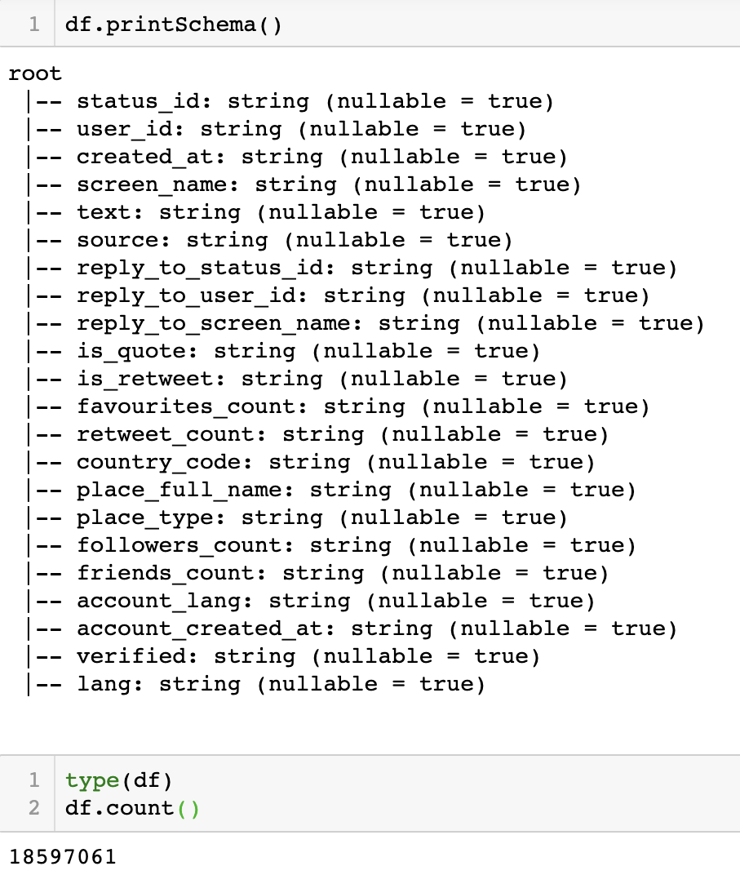
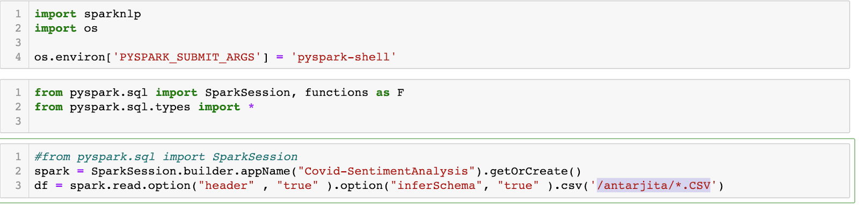
APPROACH :-
All the files are first stored in hdfs which is connected to our hive metastore and pyspark through yarn.
1) First we cleaned our data in pyspark and retained the columns necessary for further analysis.
Initial Set-up in pyspark shell:-

Slide 4

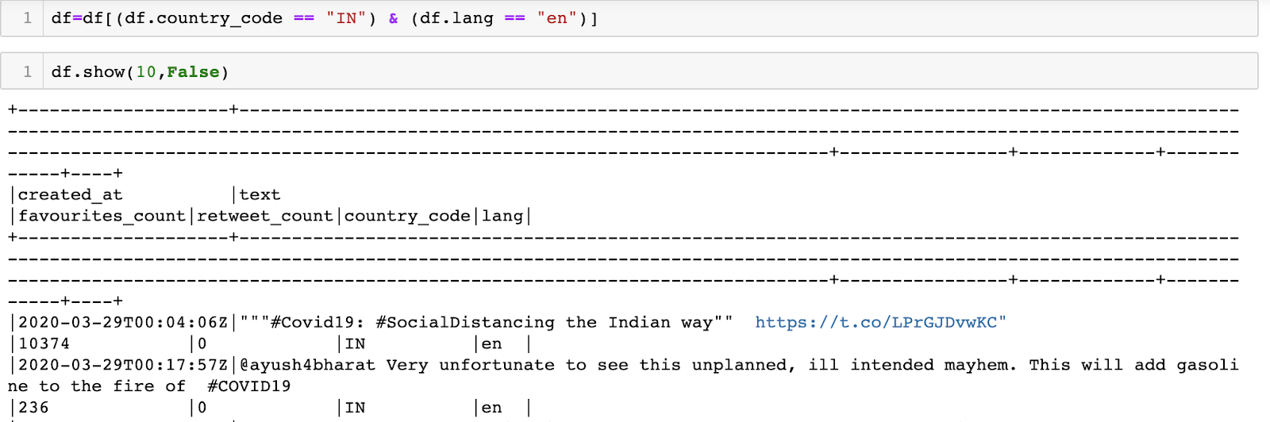
Dropping unnecessary columns :-

Slide 5
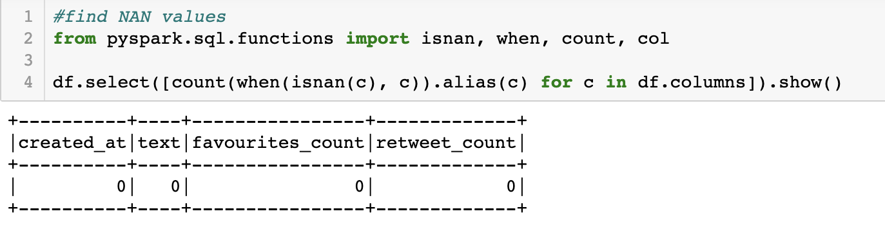
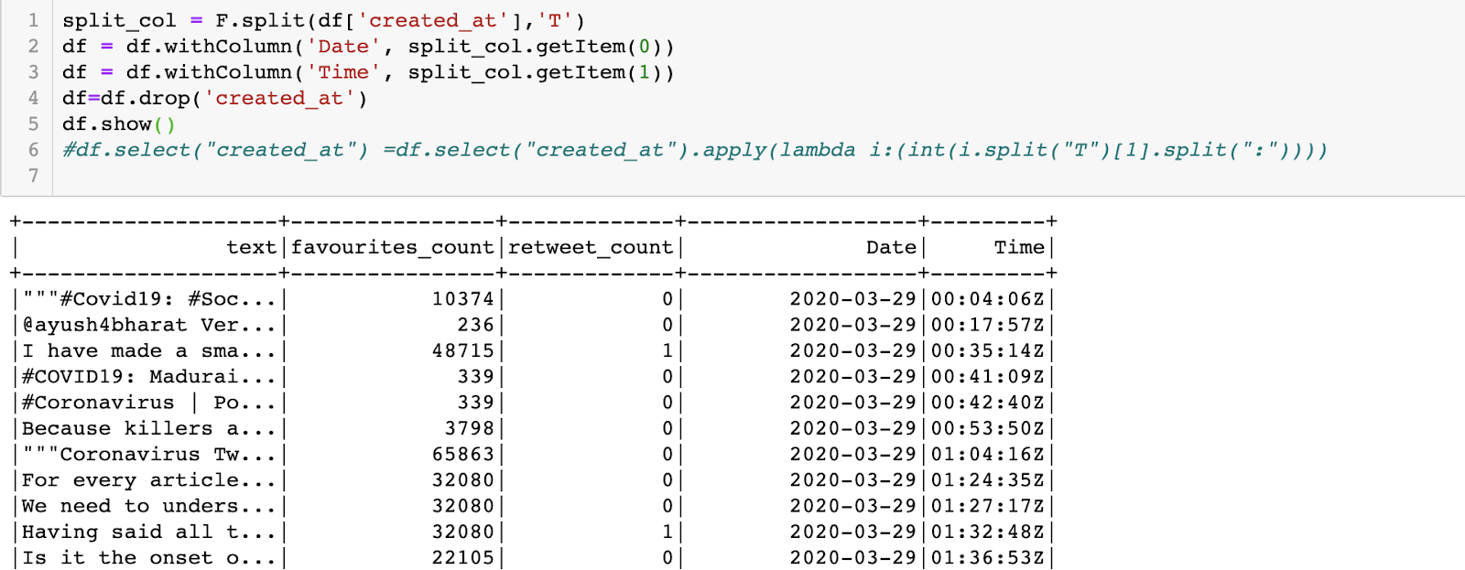
Removing Nan values and splitting created_at into valid time:-

Slide 6
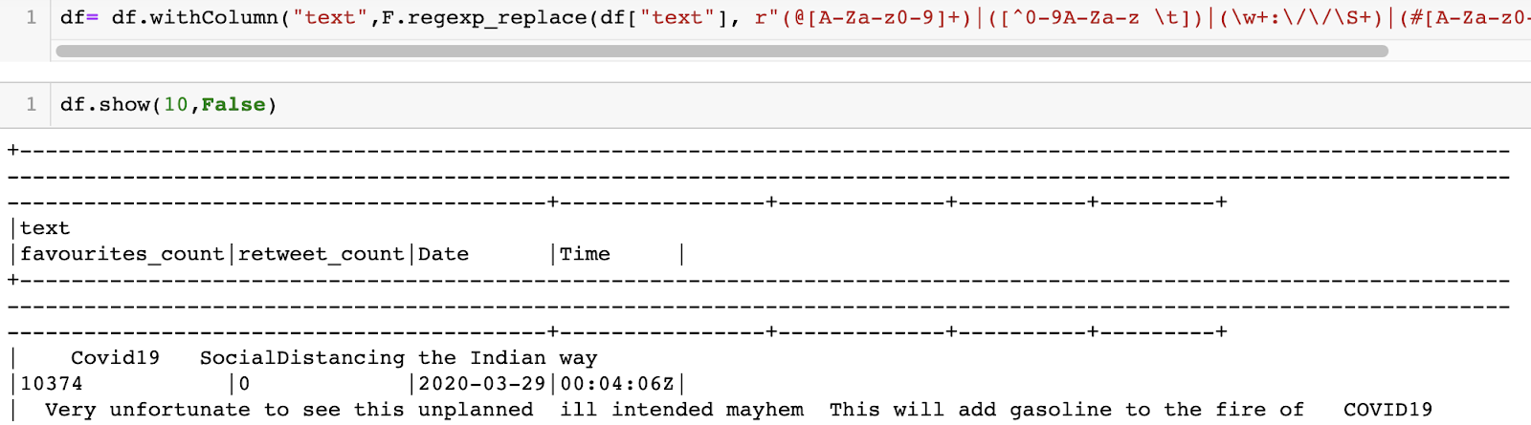
Removing special characters from the tweets:-

Slide 7
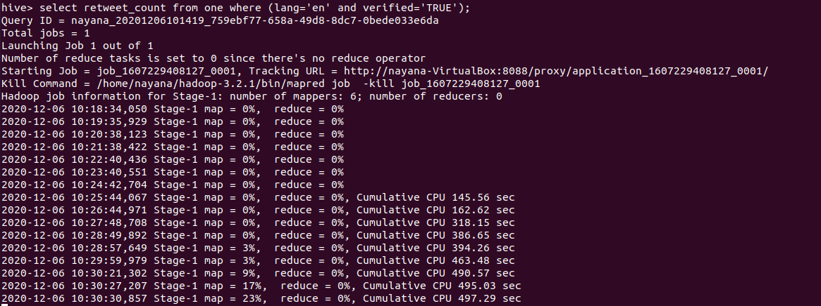

Initial insights from the data is obtained through basic querying in hive and pyspark.
select retweet_count from one where (lang=’en’ and verified=’TRUE’);
This query shows the number of retweets that all the verified accounts that tweeted in english got.
This query was used to check how popular the tweets about coronavirus by famous people were.

Slide 8
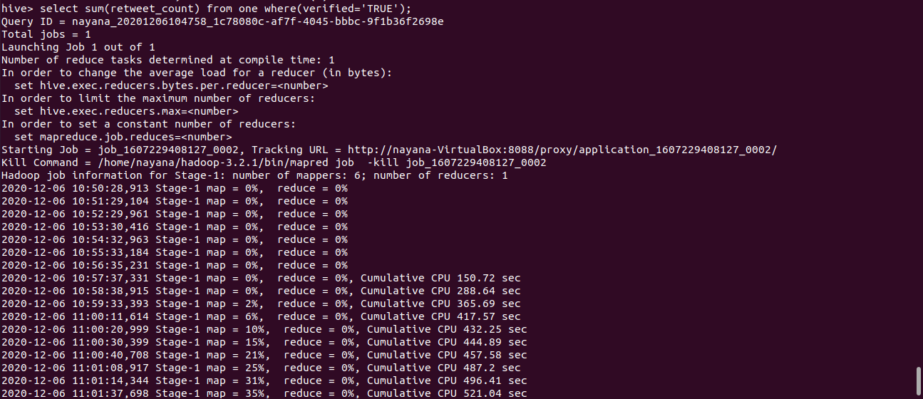
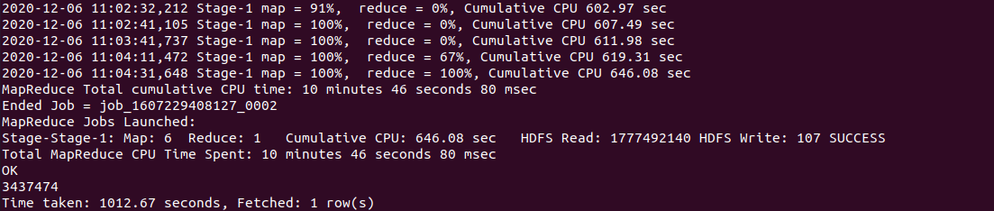
select sum(retweer_count) from one where(verified=’TRUE’)
This query finds the sum of the number of retweets of all tweets about coronavirus
By verified accounts.
This shows the importance of the topic and the engagement of the verified accounts.

Slide 9
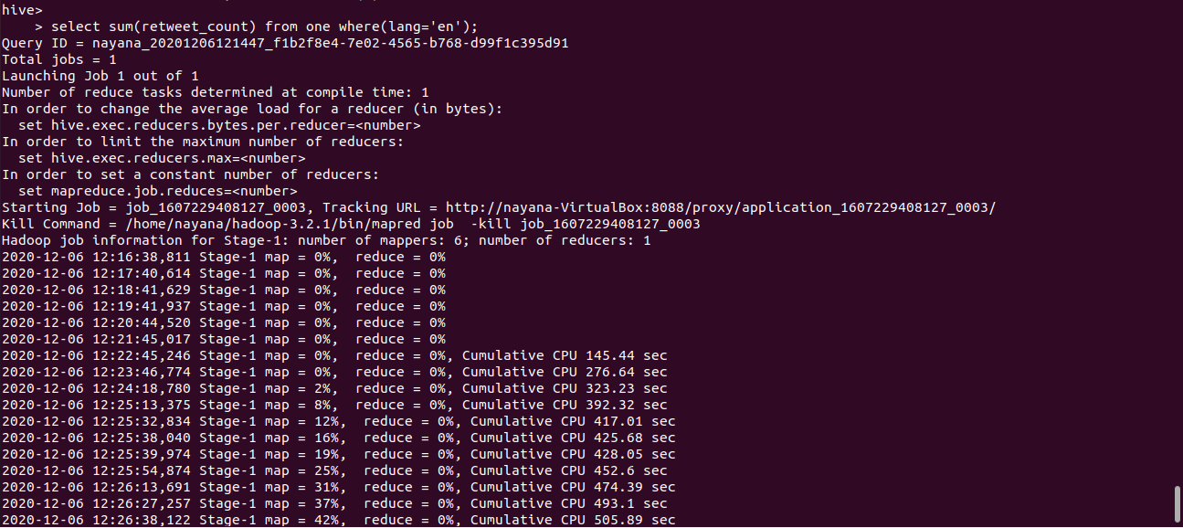
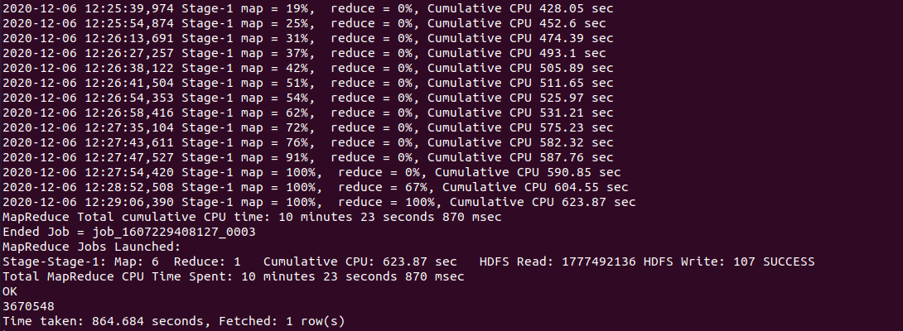
select sum(retweet_count) from one where(lang=’en’)
This query gives the number of retweet counts of all tweets on the coronavirus topic tweeted in English.

Slide 10
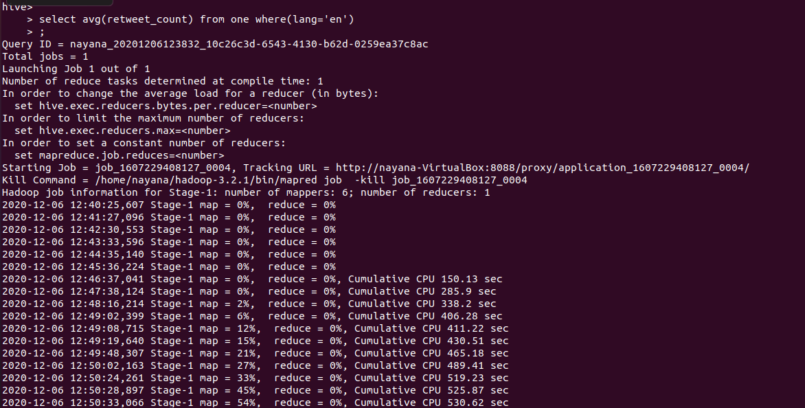
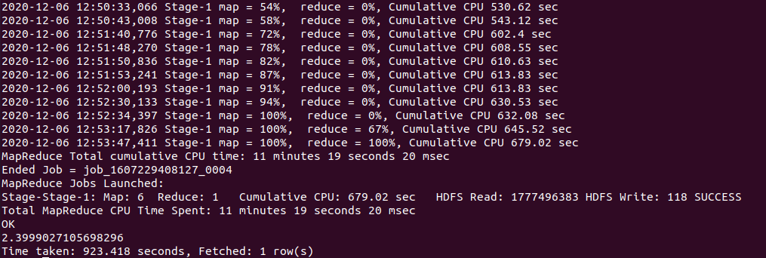
select avg(retweet_count) from one where(lang=’en’);
This query gives the average number of retweets per tweet written in english.

Slide 11
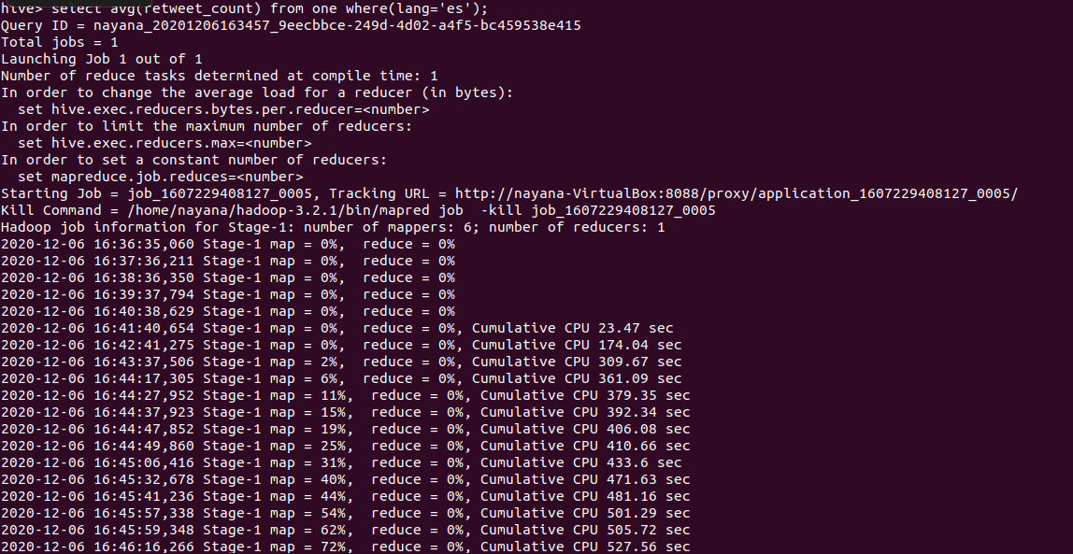
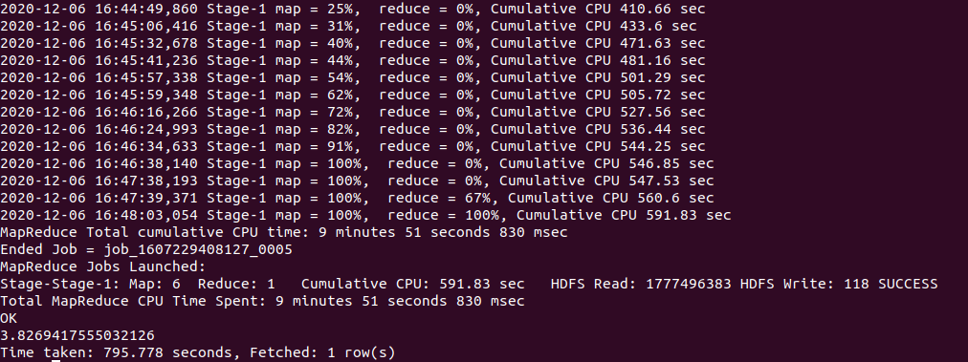
select avg(retweet_count) from one where(lang=’es’)
This gives the average number of retweets of tweets written in español
Surprisingly, according to the last two queries, the average number of retweets in español (3.8269) is greater than the average number of retweets in english (2.399).
This could probably be because English is more popular than español. Most people use English to tweet (i.e, even people who don’t have many followers, and hence lesser retweets). This might have brought down the average retweet_count.

Slide 12
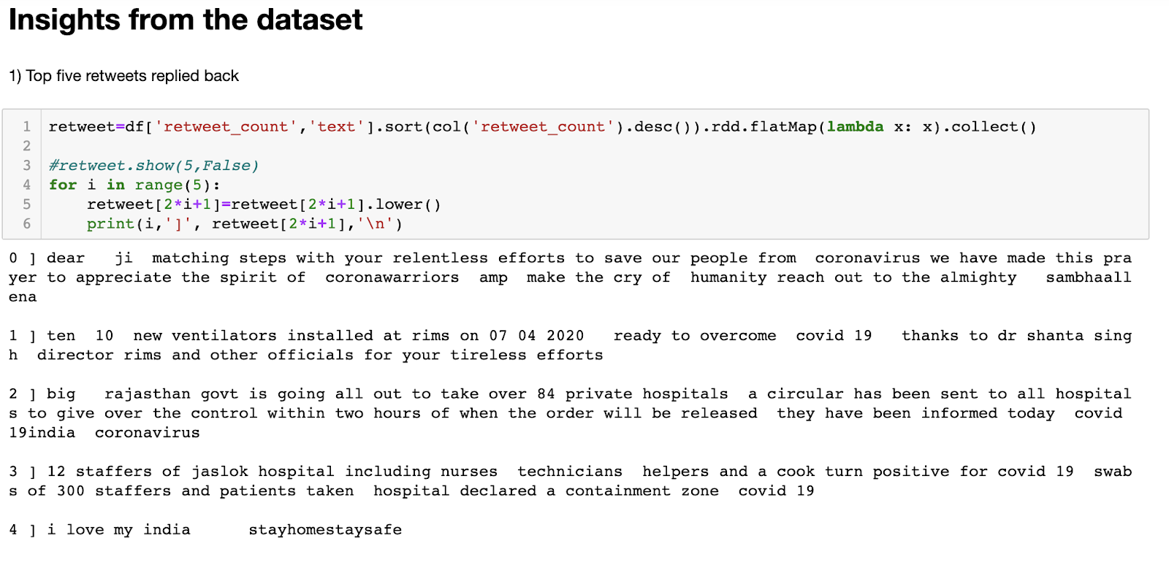
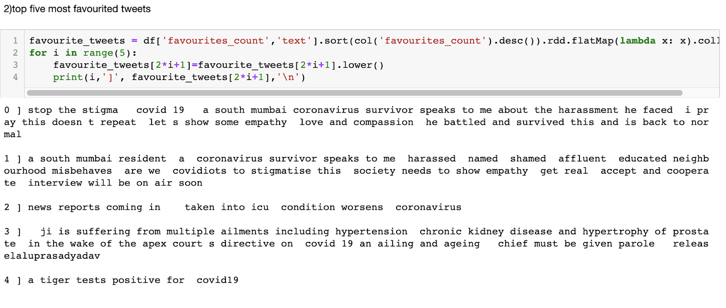
Top 5 FavouriteTweets

Slide 13
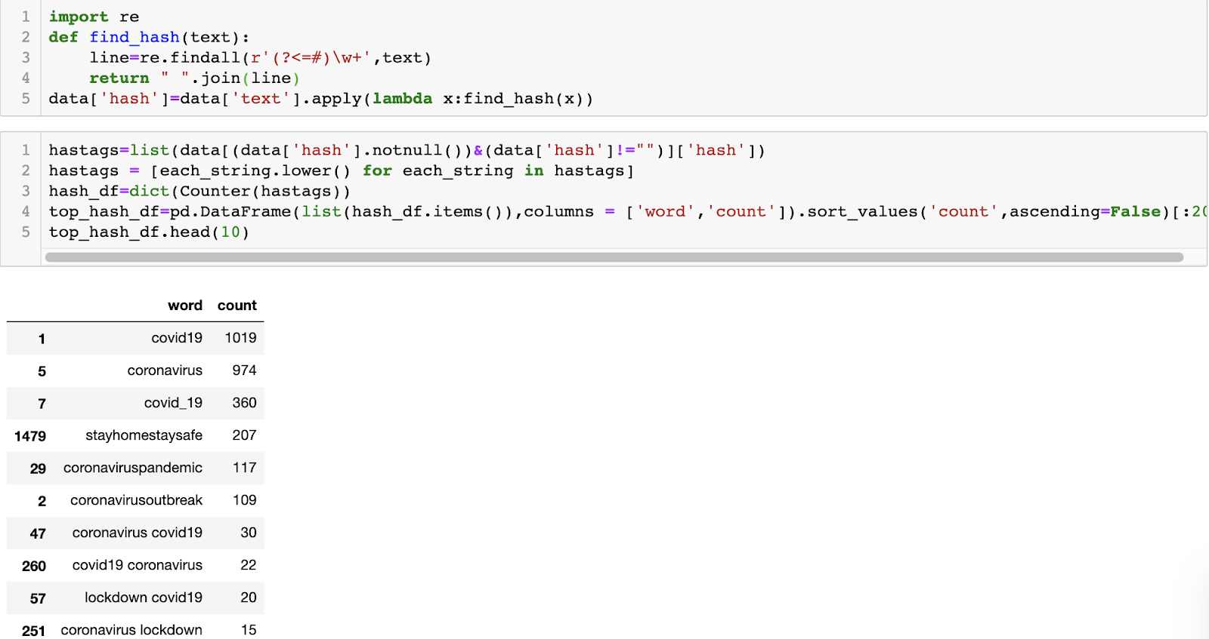
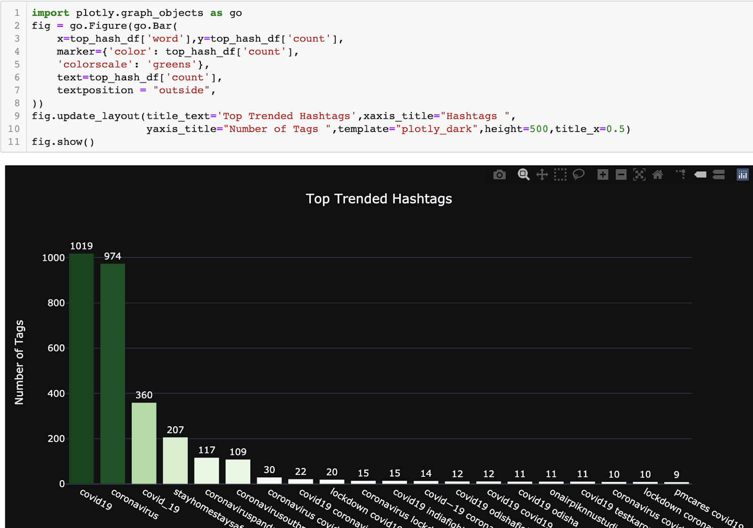
Viral Hashtags

Slide 14

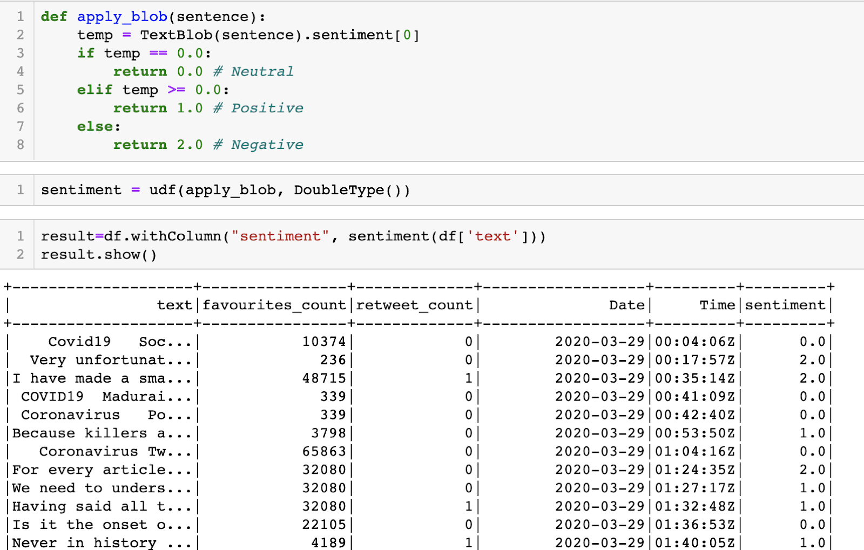
3) The sentimental analysis of the data is done in Pyspark.
Libraries imported for NLP
Checking the value of positivity, negativity or neutrality of the sentiments
Where 0.0=neutral
1.0=positive
2.0=negative

Slide 15
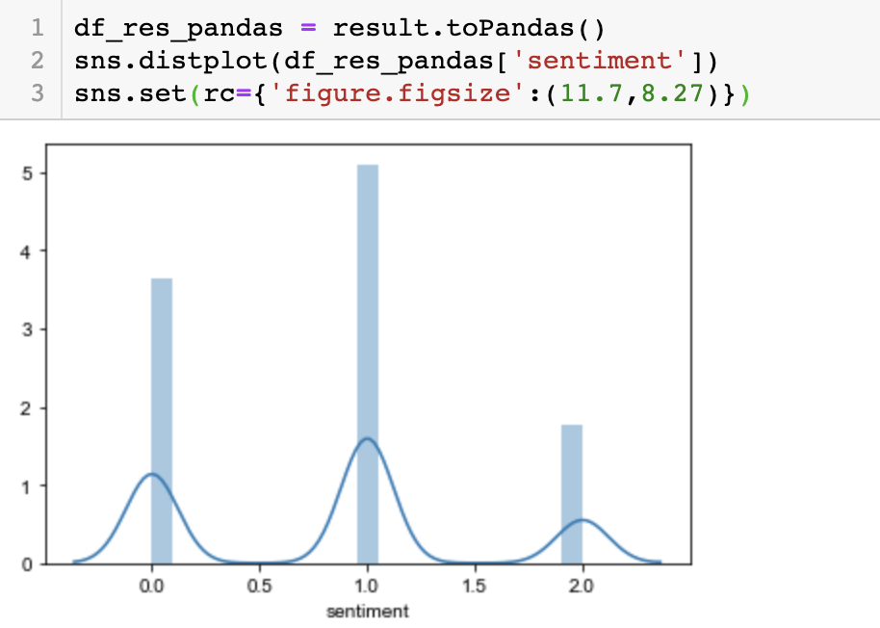
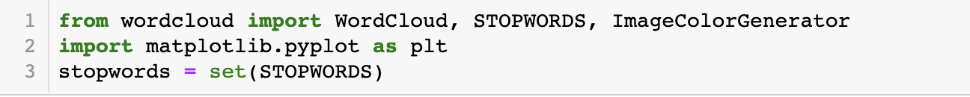
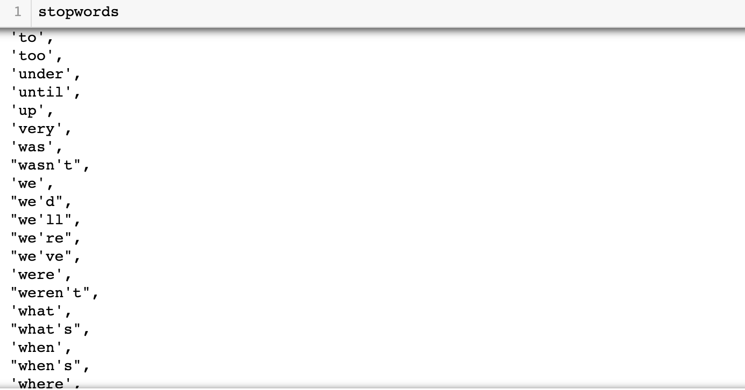
Tweets Sentiment distribution
To determine the polarity of the tweets:-

Slide 16
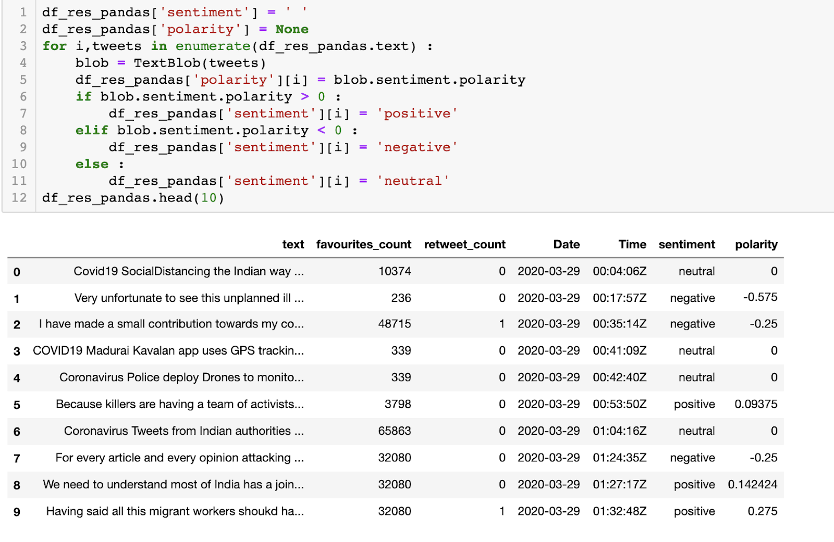
This piece of code determines how much positive, negative or neutral the tweets are.
0.09375 polarity means it is slightly positive , more towards the neutral side.

Slide 17
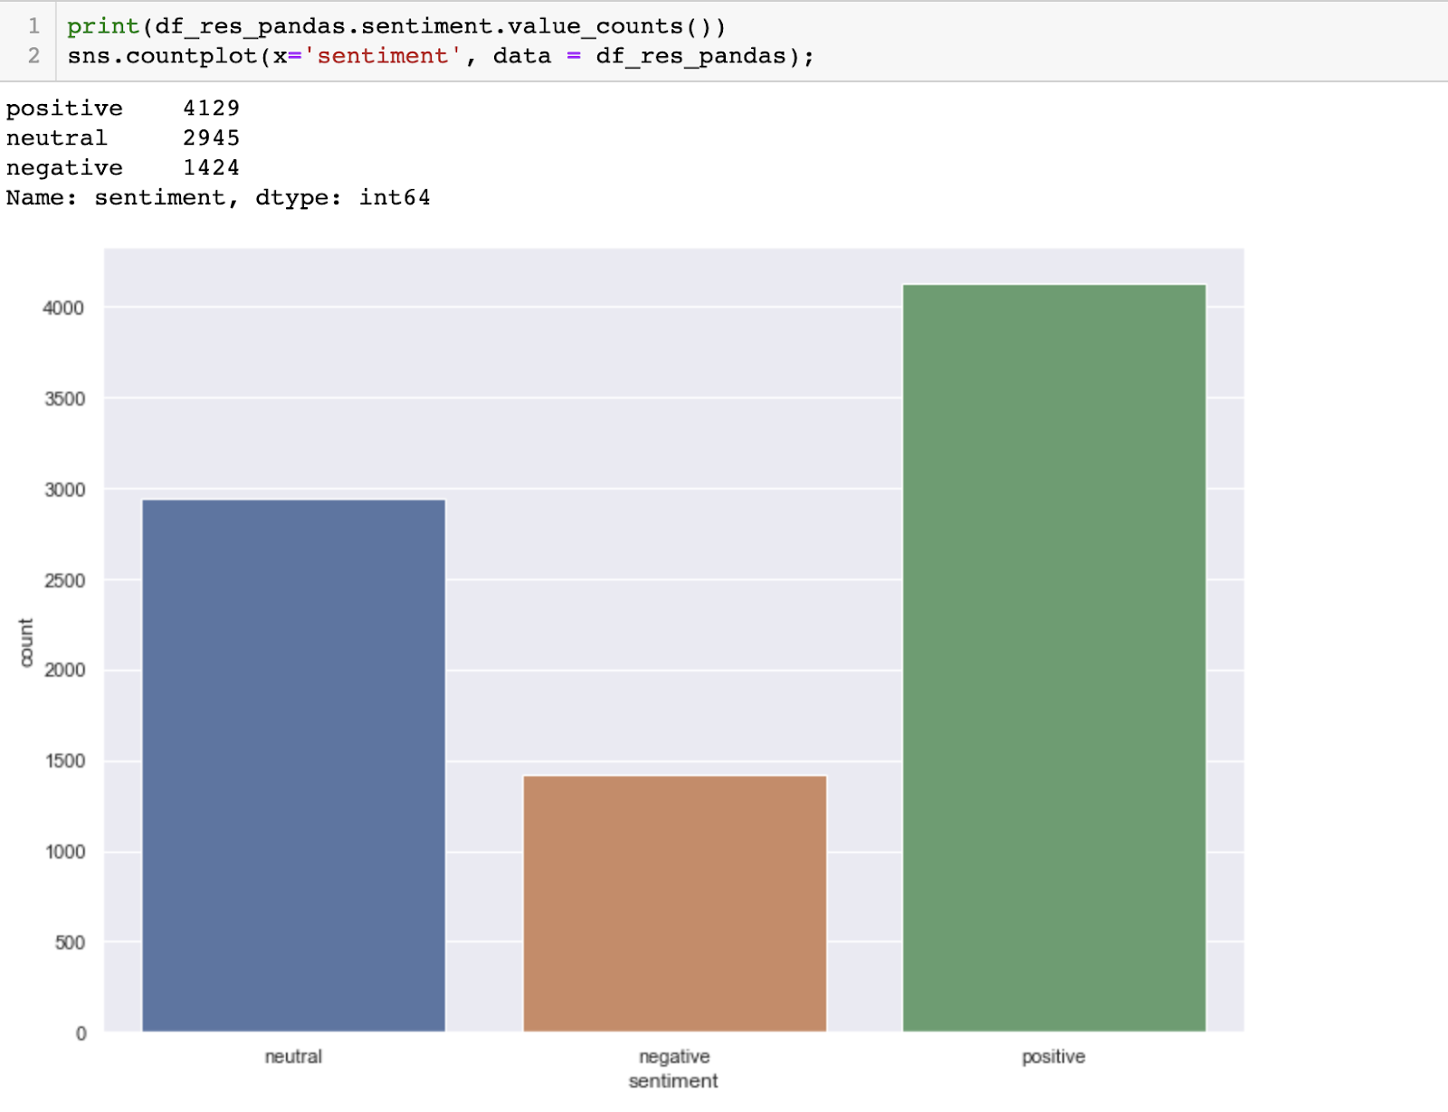
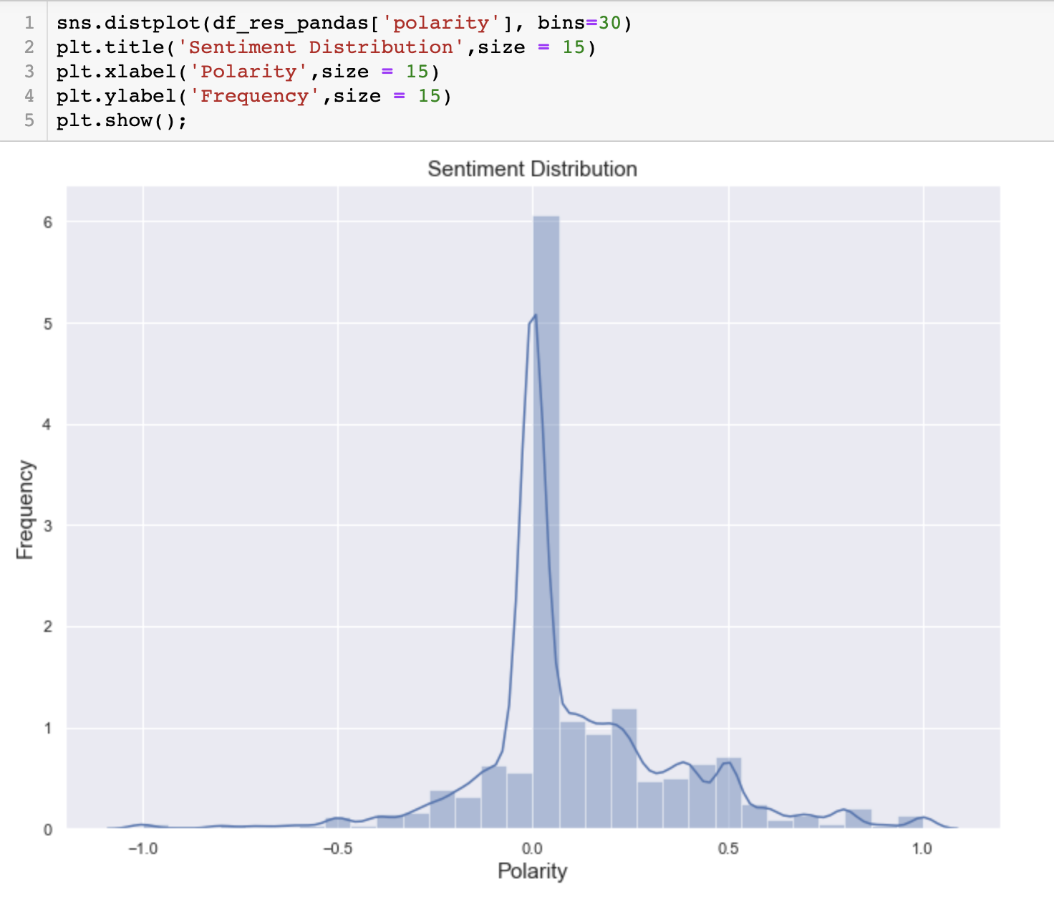
Number of positive, negative and neutral tweets

Slide 18
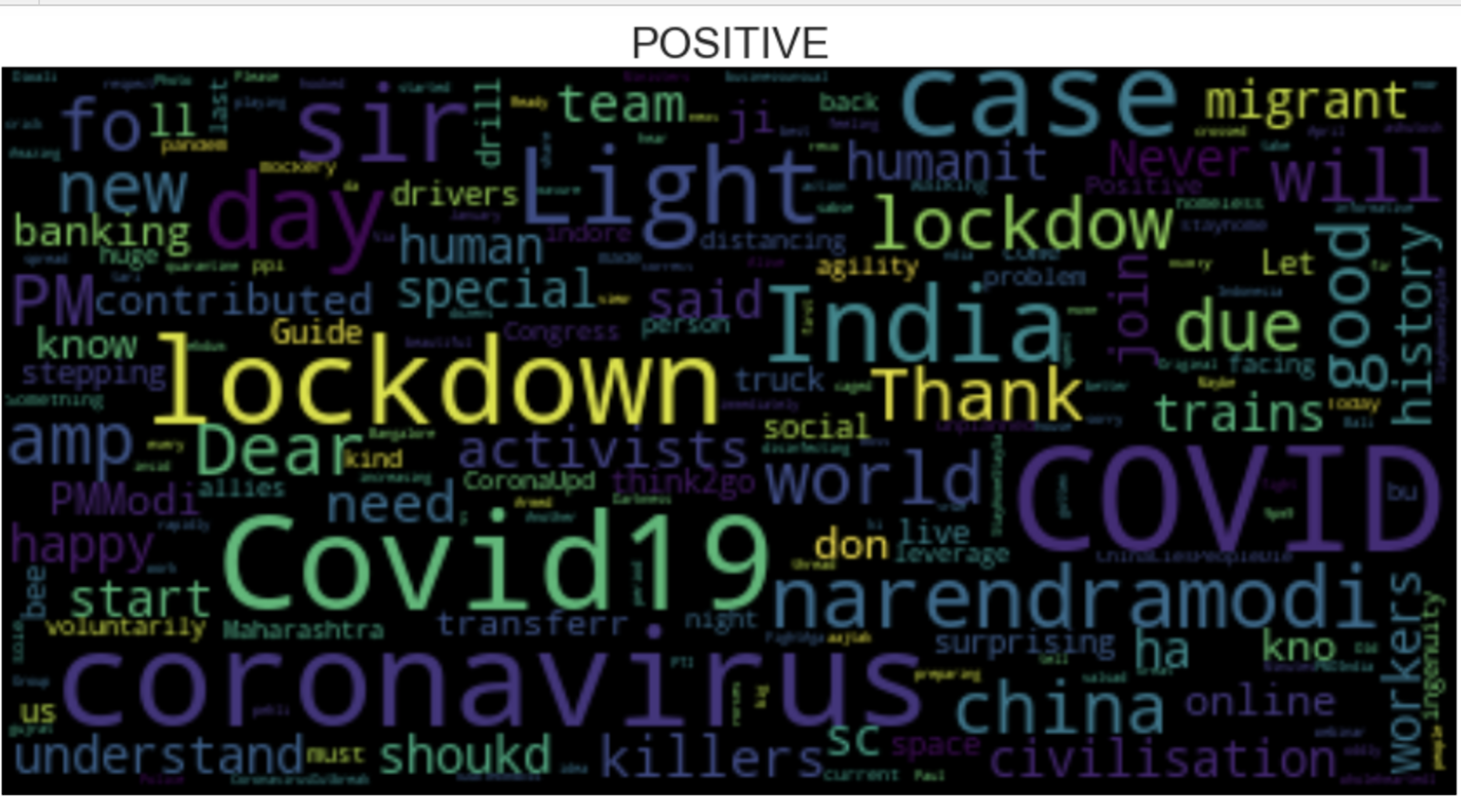
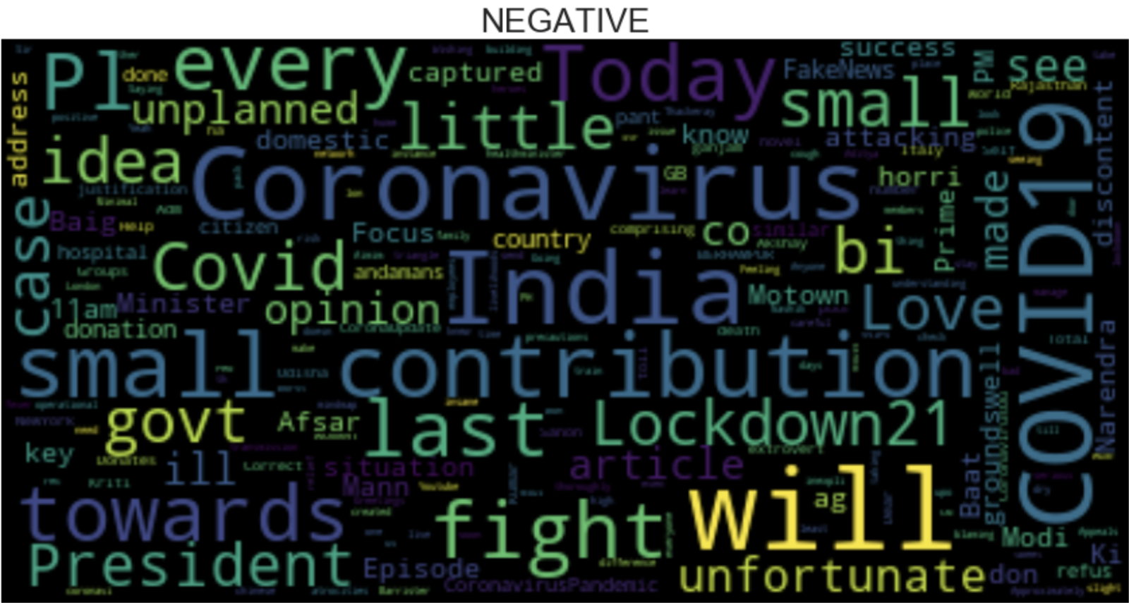
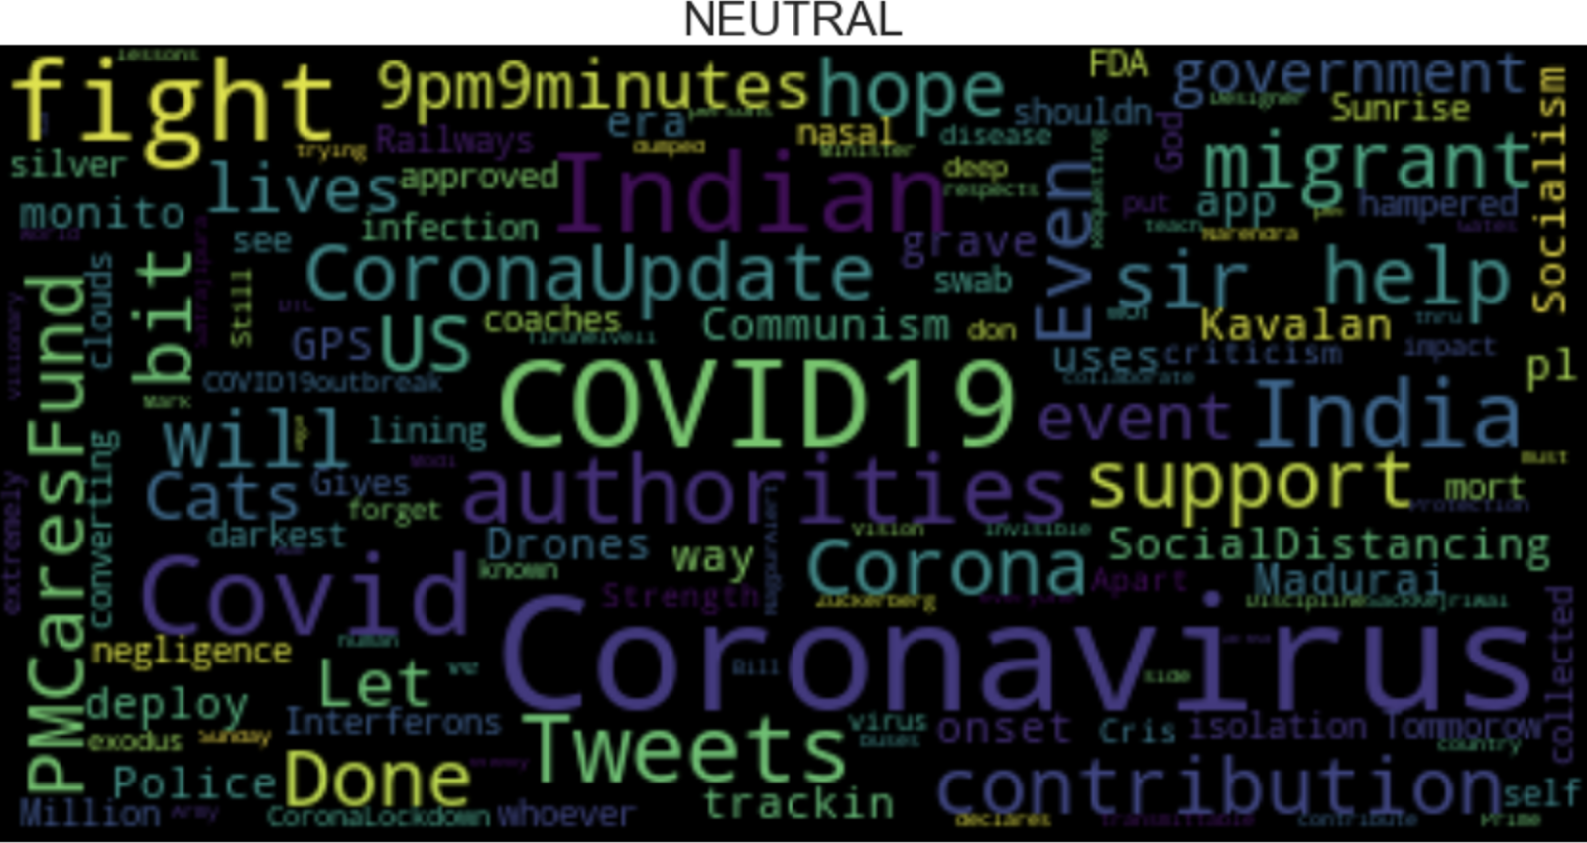
Word Clouds:-
Conclusion
Most of the tweets in the early april are towards positive or neutral side during the early stages of the pandemic.

